Slide 1

Fatigue and Dwell Fatigue studies on Ti-6242 and Ti-6246 Alloys
Presented by
Sharan Chandran
Under the guidance of
Prof. Dipankar Banerjee and Prof. Satyam Suwas
Department of Materials Engineering

Slide 2
Outline
Literature review
Introduction to titanium alloys
Introduction to Dwell Fatigue
Phenomenological aspects of Dwell Fatigue
Motivation and objective
Current work
Modelling
Experiments
Summary and future work

Slide 3
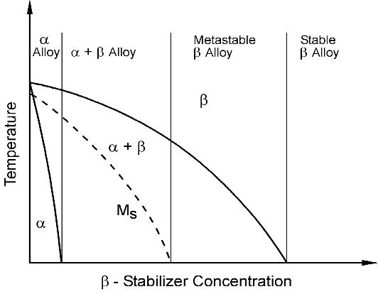
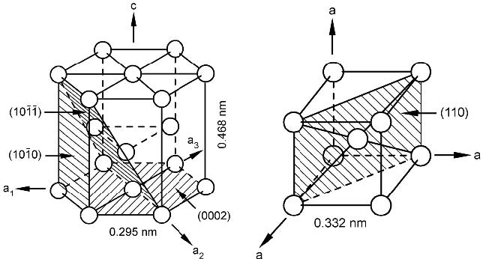
Introduction to Titanium Alloys
Alpha | Alpha + Beta | Beta

Slide 4
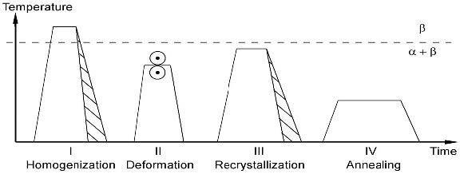
Microstructures in alpha beta Ti Alloys

Slide 5
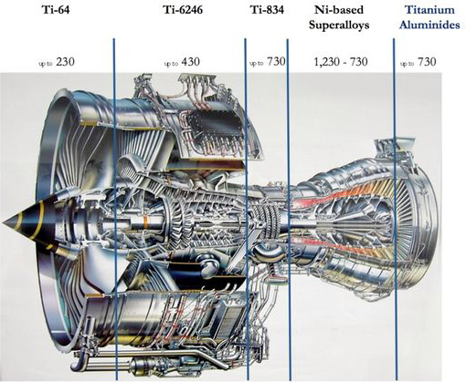
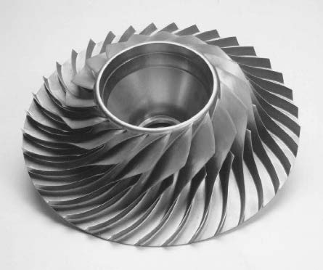
Applications of Ti-6242 and Ti-6246

Slide 6
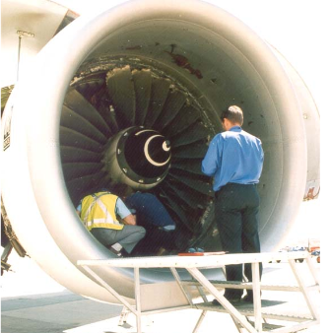
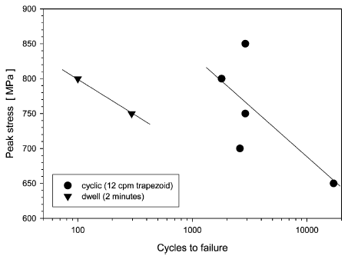
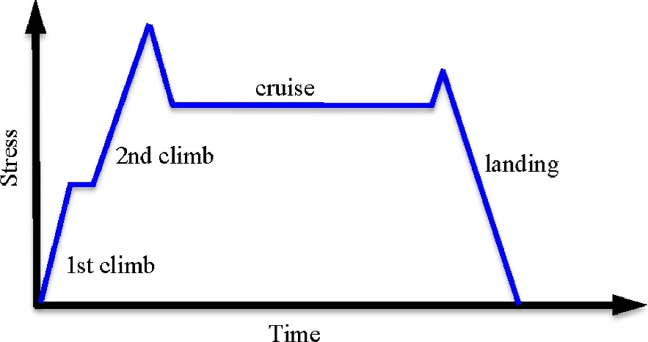
What is Dwell Fatigue ?
Ref: Wikipedia
Ref: Wikipedia
TIMETAL 685, 20°C
Fig 1. Schematic of a typical flight cycle
M.R. Bache, International Journal of Fatigue, 2003
Fig: DFD in two Ti alloys
W.J.Evans, 1998

Slide 7
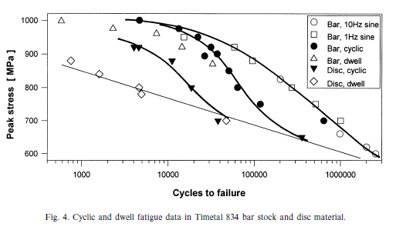
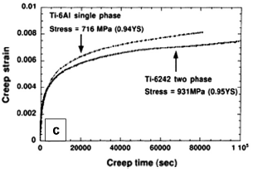
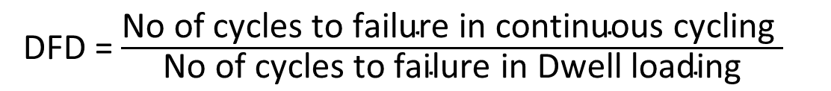
Dwell Fatigue Debit
Accelerated tests are not possible
even though there is no corrosion
or heat generation issue.
But there is creep issue
TIMETAL 834, 20°C
Why near alpha ?? In these applctins
Fig: Perspectives on Titanium Science and Technology, D. Banerjee, et.al., 2014
Fig: DFD in two Ti alloys
W.J.Evans, 2001
DFD = $\frac{\text{No} \text{of} \text{cycles} \text{to} \text{failure} \text{in} \text{continuous} \text{cycling} }{\text{No} \text{of} \text{cycles} \text{to} \text{failure} \text{in} \text{Dwell} \text{loading}}$
=1 Dwell Insensitive
>10 Highly Sensitive

Slide 8
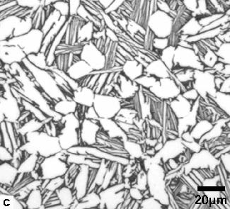
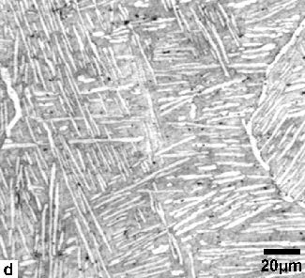
Fatigue in Ti-6242 Alloy

Slide 9
Motivation and Objectives
The nature of acceptable microstructure in Ti alloys to mitigate thr df problem I still unknown
Objective
Effect of crystallographic relationship of equiaxed, primary alpha with surrounding beta grains and the alpha/alpha grain contact on low cycle fatigue life.

Slide 11
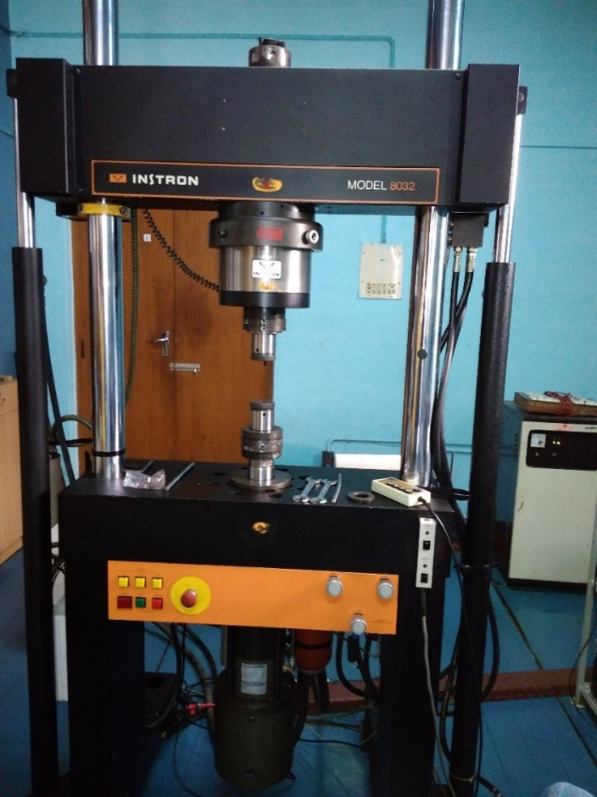
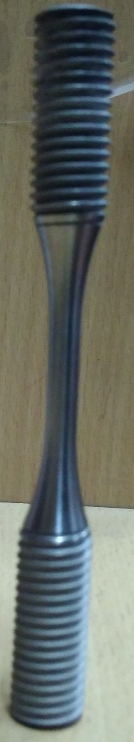
Dwell Fatigue Testing
Load Controlled Dwell Fatigue
test at RT
6mm
Surface is not very critical
in the case of dwell fatigue
as it is close to low cycle
fatigue
Vacuum Sealed and Heat treated to the desired condition
Normal fatigue
Dwell fatigue
Instron fatigue testing machine
100kN, Servo-hydraulic
Load for 0.95 proof
120 sec
Load
1s
1s
1s
Time

